Slide 1
PROGRESS ON THE ESTABLISHMENT OF CATCHMENT MANAGEMENT AGENCIES (CMAS) IN SOUTH AFRICA National Steering Committee 3 December 2013

Slide 2
Policy & Legislative Mandate
CORE BUSINESS
Policy & Legislation | Description
White Paper on Water & Sanitation, 1997 | Recognised that water resource management is best undertaken through an integrated approach and the most appropriate unit for this to be done was on a catchment or systems basis. (Principle 22)
National Water Act, 1998 | Catchment Management Agencies (CMAs) are established in terms of Chapter 7 of the Act .
Public Finance Management Act , | National Public Entities listed as Schedule 3A under PFMA.
National Water Resource Strategy-2 | Chapter 8 on Water Management Institutions including plan to establish 9
Raw Water Pricing Strategy, 2007 | Defines Water Resource Management functions to be charged to users and funding framework for CMAs.
National Development Plan, 2012 | CMAs to be established by 2015.

Slide 3
WATER RESOURCE MANAGEMENT ACTIVITIES
Monitoring &
assessing water
resource availability
and use
Water use
allocations
Planning &
implementation
of CMSs
Water Resources
Management
Activities in WMAs
Management of
floods, droughts,
water abstraction,
Etc.
Institutional
development &
public partici-
pation
Management of
water quality water
& resource
protection
Water
conservation &
demand
management

Slide 4
CONTRIBUTION TO GOVERNMENT OUTCOMES
6
Efficient economic infrastructure
9
responsive, accountable, effective & efficient local
government
4
Employment & inclusive growth
10
Protected and enhanced environment and natural resources
7
Vibrant & sustainable rural communities
Effective water resources management critical foundation to achieve the above outcomes

Slide 5
CORE BUSINESS
TOP TEN RISKS
PROGRESS AND KEY TIMELINES
19 March 2012 | Minister approved the establishment of nine CMAs in nine WMAs
21 May 2012 | Gazetting of WMAs for public consultation approved.
June 2012 | National Steering Committee established to oversee implementation (DWA, National Treasury, SALGA,CMAs, Civil Society.) 4th NSC to be held on 3rd December
July 2013 | Business Cases and Proposals for Inkomati-Usuthu and Breede-Gouritz CMAs gazetted for 60 for public comments
16 August 2013 | NWRS Gazetted published including boundaries of nine WMA.
September 2013 | Board appointment process for Inkomati-Usuthu, Breede-Gouritz Limpopo, Pongola Umzimkhulu, commenced

Slide 6
CORE BUSINESS
TOP TEN RISKS
PROGRESS AND KEY TIMELINES
October 2013 | Business cases and Proposals for Pongola UMzimkhulu and Limpopo CMAs approved by Minister for gazetting establishment notices for comment
November 2013 | Gazette notices for the establishment of Pongola UMzimkhulu and Limpopo CMAS for public comment published on 8 November 2013
January 2014 | Joint evaluation committee coordinated by NT to evaluate business cases and list entities in PFMA
February 2014 | Inkomati-Usuthu and Breede Gouritz CMAs gazetted for establishment
March 2014 | Board appointments for Inkomati-Usuthu and Breede Gouritz approved by the Minister

Slide 7
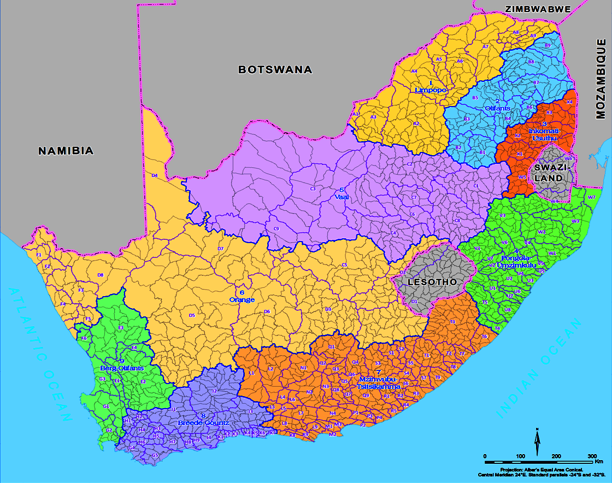
Water Management Areas
Limpopoo
Olifants
Inkomati-
Usuthu
Vaal
Orange
Pongola-Mzimkulu
Berg-Olifants
Mzimvubu-Tsitsikamma
Breede-Gouritz

Slide 8
HIGH LEVEL PROJECT PLAN FRAMEWORK
Aug12-July 13
Aug13-July 14
Aug 14-July 15 and beyond
Approach
CMA IMPLEMENTATION PLAN
Preparatory Phase
Establishment Phase
Operation Phase
Sustain & Improve
Gazetting of WMAs
1 Month
Implementation of Initial Functions
Delegation of functions
Project Phases
Cross Cutting Activities
Finalising Business Cases
Approval of Business Cases by NT and listing under PFMA
Office Accommodation
2 Months
Setting up of National Steering Committee
Gazetting of CMAs
Human Resources
8 Months
Setting up of Regional Steering Committees
Appointment of Governing Board
Systems
1 Month
Appointment of dedicated team
Appointment of Chief Executive
Budget secured MTEF
Time Frames
PHASE 1 : Breede-Gouritz, Inkomati-Usuthu and Pongola Mzimkhulu
PHASE 2 : Berg-Olifants-Doorn , Vaal , Olifants and Limpopo
PHASE 3 : Orange, Mzimvubu-Keiskamma
Aug12-July 13
Aug13-July 14
Aug14-July 15 and beyond

Slide 9
SUMMARY OF STAKEHOLDER ENGAGEMENT ACTIVITIES: INKOMATI-USUTHU

Slide 10
SUMMARY OF STAKEHOLDER ENGAGEMENT ACTIVITIES: INKOMATI-USUTHU

Slide 11
SUMMARY OF STAKEHOLDER ENGAGEMENT ACTIVITIES: BREEDE GOURITZ

Slide 12
SUMMARY OF STAKEHOLDER ENGAGEMENT ACTIVITIES: BREEDE GOURITZ

Slide 13
PROGRESS AND KEY TIMELINES
CMAs functions and Delegations Task Team
Draft delegation of functions document
Aligned the delegation and information systems matrix document included into an institutional business model
Monitoring and Information Systems Task Team
Draft information systems matrix whish includes systems, enabling environment and resources
Business model presented to National steering committee on 03 December 2013, to DWA Top Management in January 2014 and the Minister in March 2014

Slide 14
PROGRESS AND KEY TIMELINES
Financial Viability and Sustainability Task Team
Draft financial policy for CMAS
Ring fence Proto CMA (functions and budget)in the regional offices
Proposal to utilize SAP in CMAs
Human resource transfer task team
Endorsed National Change and Communication strategy
Endorsed CMA generic structure
Draft Transfer Agreement aligned to WS and guidelines from DPSA
CMA’s to register with GEPF as pension provider
CMA’s to align to Public Service Conditions
Present to NSC on 03 December 2013, to Top Management in January 2014 and to the Minister in March 2014

Slide 15
NEXT STEPS
Fast track development of CMA business cases for gazetting
Vaal, Berg-Olifants, Mzimvubu-Tsitsikamma and Orange CMAs
Ongoing consultation with Labour –National and Regional level
National Treasury to list Inkomati-Usuthu and Breede Gouritz CMAs
Task teams to finalize and present their recommendation to the NSC for endorsement to top management
Selection process for governing boards commenced for Inkomati-Usuthu and Breede Gouritz CMAs In

Slide 16
DWA’s OVERSIGHT ROLE OVER CMAs Compliance monitoring
List of Documents submitted to the Minister | Legislation
Annual Report & Audited Financial Statements | PFMA: Sec 55 (d)
Business Plans | TR 30.1.1 and Schedule 4 of the National Water Act, 1998
Budget of estimated revenue & expenditure for the year | PFMA: Sec 53(1)
Quarterly Reports on actual revenue & expenditure for the quarter & projection of expected expenditure & revenue for remainder of financial year | TR 26.1 TR 30.2.1
Financial misconduct procedures report | TR 33.3.1
16

Slide 17
PROTOCOL ON SUBMISSIONS OF APP
DWA Goals, objectives and targets forwarded to entities by end June
1st draft of the Entities APP submitted to DWA in August
1st draft of the DWA APP submitted to NT at end of August –including inputs from entities
2nd draft of the DWA and Entities APP reviewed by 15th of November
Submit draft DWA APP to NT and DPME by end November

Slide 18
PROTOCOL ON SUBMISSION OF APP
1st Draft DWA ENE including input from entities submitted to NT by 6 December
Final DWA ENE submitted to NT by end of January
Entities submit the final APP to DWA by end January for Minister’s approval by 15 Feb together with the DWA APP
Budget vote speech 2nd week of February
Tabling of final DWA APP to Parliament by end of Feb

Slide 19
COMMENTS/QUESTIONS THANK YOU

